Slide 1
PROBLEM # 1
Checking for element uniqueness in an array:
Consider an array of elements and determine if every element in the array is unique.
Have we already seen this problem? If yes, how did we solve it?
21 | 2 | 15 | 99 | 260 | 20 | 15 | 80 | No
Left
180 | 60 | 30 | 1 | 2 | 4 | 12 | 24 | Yes

Slide 2
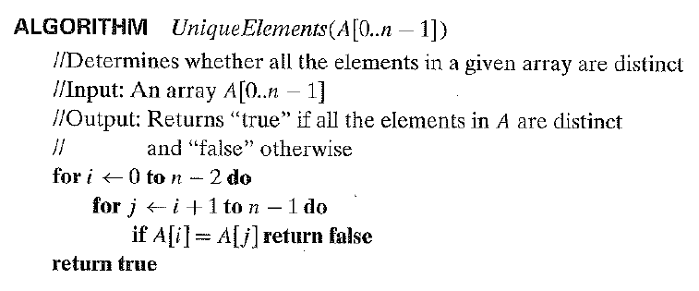
SOLUTION
What is the design strategy and time efficiency of this algorithm?

Slide 3
SOLUTION
This algorithm is designed using Brute Force design strategy.
Its worst – case efficiency is Θ(n²).
Can we improve the efficiency of this algorithm from Θ(n²) to Θ(n)?
If so, how?

Slide 4
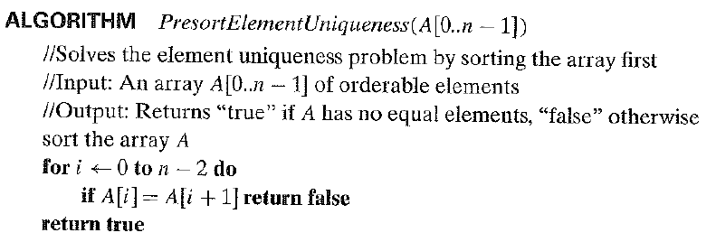
PRESORTING

Slide 5
PRESORTING
The worst – case efficiency of this algorithm is:
T(n) = T_{sort}(n) + T_{scan}(n)
ϵ Θ(n log n) + Θ(n)
= Θ (n log n)
Thus, this algorithm is better than the brute – force algorithm if a n log n sorting algorithm is used.

Slide 6
PRESORTING
This algorithm solves the problem of Element Uniqueness by first transforming the given input unsorted array to a sorted array and then checks only consecutive elements: if the array has equal elements, a pair of them must be next to each other and vice versa.
This algorithm design strategy of transforming the given input instance to something more amenable to the solution and then solving it is called Transform and Conquer.

Slide 7
TRANSFORM AND CONQUER

Slide 8
THE IDEA
The transform-and-conquer algorithms work as two-stage procedures.
First, in the transformation stage, the problem's instance is modified to be, for one reason or another, more amenable to solution.
Then, in the second or conquering stage, it is solved.
The transform-and-conquer idea has three major variations.

Slide 9
VARIATIONS
Instance Simplification
Transformation to a simpler or more convenient instance of the same problem
Representation Change
Transformation to a different representation of the same instance
Problem Reduction
Transformation to an instance of a different problem for which an algorithm is already available

Slide 10
PRESORTING
The presorting idea is an example of the Instance Simplification variety.
Many questions about lists are easier to answer if the lists are sorted.
The time efficiency of the algorithms that involve sorting will depend on the time efficiency of the sorting algorithm.

Slide 11
PROBLEM # 2
Computing a mode:
A mode is a value that occurs most often in a given list of numbers.
What is the Brute Force way of solving this problem?
1 | 2 | 2 | 4 | 1 | 5 | 4 | 4 | Mode = 4

Slide 12
SOLUTION
Scan the list and compute the frequencies of all its distinct values, then find the value with the largest frequency.
In order to implement this idea, we can store the values already encountered, along with their frequencies, in a separate list.
On each iteration, the i^{th} element of the original list is compared with the values already encountered by traversing this auxiliary list.
If a matching value is found, its frequency is incremented; otherwise, the current element is added to the list of distinct values seen so far with a frequency of 1.

Slide 13

EFFICIENCY
Worst – case input: A list with no matching elements.
For such a list, its i^{th} element is compared with i – 1 elements of the auxiliary list of distinct values seen so far before being added to the list with a frequency of 1.
The number of comparisons made by this algorithm is:

Slide 14
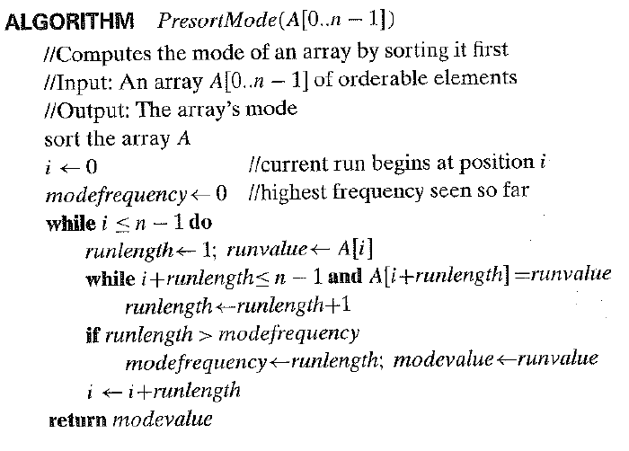
PRESORTING SOLUTION

Slide 15
PRESORTING
The worst – case efficiency of this algorithms is:
T(n) = T_{sort}(n) + T_{scan}(n)
ϵ Θ(n log n) + Θ(n)
= Θ (n log n)
Thus, this algorithm is better than the brute – force algorithm if a n log n sorting algorithm is used.

Slide 16
PROBLEM # 3
Searching:
Searching for a given value v in a given array of n sortable items.
What is the Brute Force way of solving this problem?
14 | 32 | 12 | 4 | 100 | 56 | 84 | 93 | v = 40 | Not Found

Slide 17
BRUTE FORCE SOLUTION
The Brute Force solution to this problem is Sequential Search.
The worst – case efficiency of this algorithms is Θ(n).

Slide 18
PRESORTING SOLUTION
The presorting solution to this problem is Binary Search whose running time will be:
This efficiency is inferior to sequential search.

Slide 19
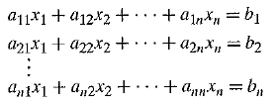
GAUSSIAN ELIMINATION
In many applications we need to solve a system of linear equations like the one below:
An elegant solution to solving such a system of linear equations is Gaussian Elimination.

Slide 20
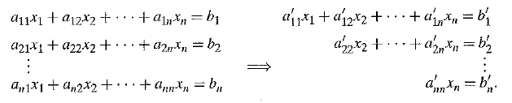
GAUSSIAN ELIMINATION – THE IDEA
The idea of Gaussian Elimination is to transform a system of n linear equations in n unknowns to an equivalent system with an upper triangular co – efficient matrix, a matrix with all zeros below its diagonal.

Slide 21
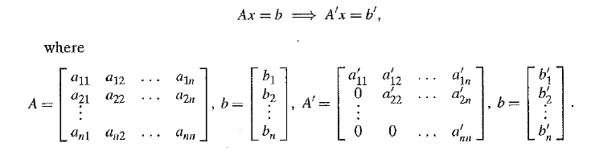
GAUSSIAN ELIMINATION – THE IDEA
The matrix representation of the system is:

Slide 22
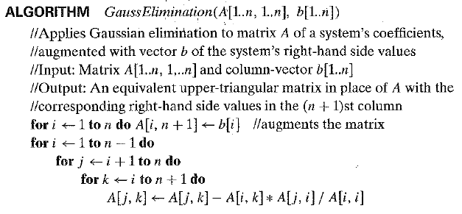
GAUSSIAN ELIMINATION – THE ALGORITHM

Slide 23
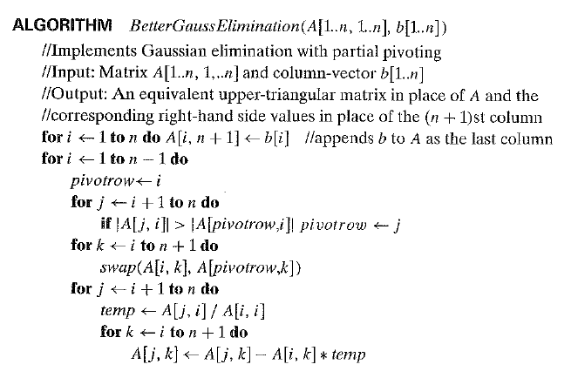
GAUSSIAN ELIMINATION – BETTER ALGORITHM

Slide 24
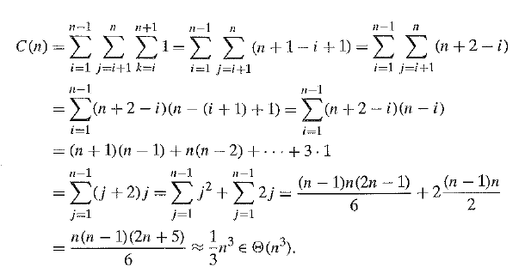
GAUSSIAN ELIMINATION – TIME EFFICIENCY

Slide 25
BALANCED SEARCH TREES
A Binary Search Tree is a binary tree whose nodes contain elements of a set of orderable items, one element per node, so that all elements in the left subtree are smaller than the element in the subtree's root, and all the elements in the right subtree are greater than it.
Example of Representation Change.

Slide 26
BALANCED SEARCH TREES
The time efficiency of searching, insertion, and deletion, which are all in Θ(log n), but only in the average case.
In the worst case, these operations are in Θ(n) because the tree can degenerate into a severely unbalanced one with its height equal to n - 1.
Computer scientists have come up with two approaches which preserve the logarithmic efficiency of dictionary operations but avoids its worst case degeneracy.

Slide 27
AVL TREES
An AVL tree is a binary search tree in which the balance factor of every node, which is defined as the difference between the heights of the node's left and right subtrees, is either 0 or + 1 or -1. (The height of the empty tree is defined as -1.)
If an insertion of a new node makes an AVL tree unbalanced, we transform the tree by a rotation.
A rotation in an AVL tree is a local transformation of its subtree rooted at a node whose balance has become either +2 or -2; if there are several such nodes, we rotate the tree rooted at the unbalanced node that is the closest to the newly inserted leaf.

Slide 28
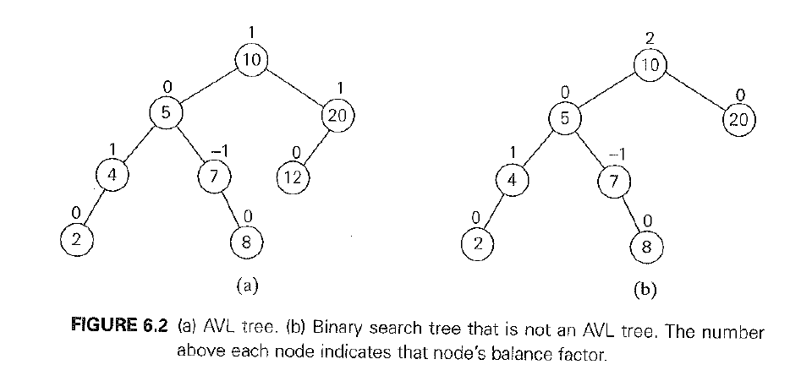
AVL TREES

Slide 29
AVL TREES - ROTATIONS
There are only four types of rotations
Single Right Rotation or R Rotation
Single Left Rotation or L Rotation
Double Left Right Rotation or LR Rotation
Double Right Left Rotation or RL Rotation

Slide 30
AVL TREES - ROTATIONS
There are only four types of rotations
Single Right Rotation or R Rotation
Single Left Rotation or L Rotation
Double Left Right Rotation or LR Rotation
Double Right Left Rotation or RL Rotation

Slide 31
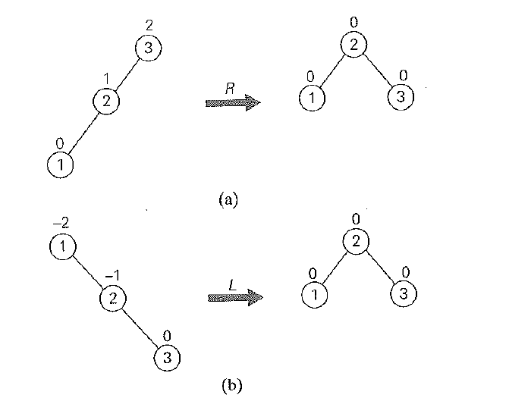
AVL TREES - ROTATIONS
R Rotation
L Rotation

Slide 32
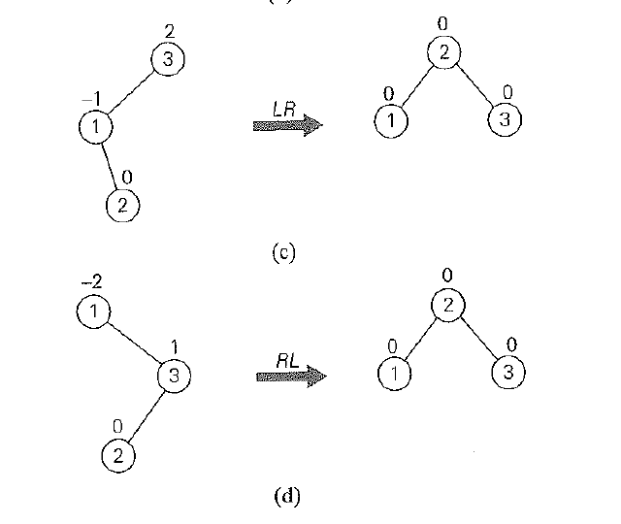
AVL TREES - ROTATIONS
c) LR Rotation
d) RL Rotation

Slide 33
AVL TREES - EFFICIENCY
The operations of insertion, deletion and searching is logarithmic i.e., it belongs to
Θ(log n).

Slide 34
2 – 3 TREES
A 2-3 tree is a tree that can have nodes of two kinds: 2-nodes and 3-nodes.
A 2-node contains a single key K and has two children: the left child serves as the root of a subtree whose keys are less than K and the right child serves as the root of a subtree whose keys are greater than K.
A 3-node contains two ordered keys K1 and K2 (K1 < K2) and has three children. The leftmost child serves as the root of a subtree with keys less than K1, the middle child serves as the root of a subtree with keys between K1 and K2, and the rightmost child serves as the root of a subtree with keys greater than K2.

Slide 35
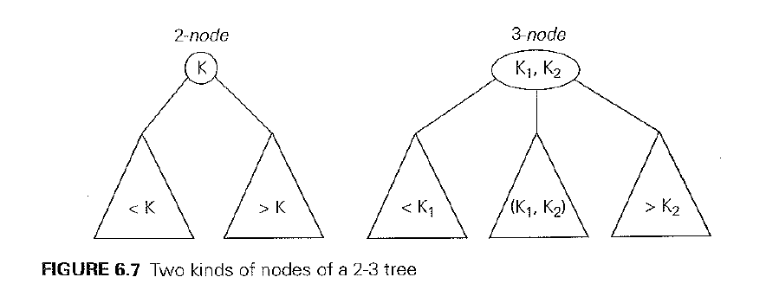
2 – 3 TREES

Slide 36
2 – 3 TREES
The last requirement of the 2-3 tree is that all its leaves must be on the same level, i.e., a 2-3 tree is always perfectly height-balanced: the length of a path from the root of the tree to a leaf must be the same for every leaf.
The operations of insertion, deletion and searching can be applied to 2 – 3 Trees.

Slide 37


2 - 3 TREES - EFFICIENCY
For any 2-3 tree of height h with n nodes, we get the inequality
And hence:

Slide 38


2 - 3 TREES - EFFICIENCY
On the other hand, a 2 – 3 tree of height h with the largest number of keys is a full tree of 3 – nodes, each with two keys and three children. Therefore:
And hence:
The lower and upper bounds on height h:

Slide 39
2 - 3 TREES - EFFICIENCY
These upper and lower bounds indicate that the searching, insertion and deletion are all in Θ(log n).

Slide 40
HEAPS AND HEAPSORT
Definition:
A heap can be defined as a binary tree with keys assigned to its nodes (one key per node) provided the following two conditions are met:
1. The tree's shape requirement - The binary tree is essentially complete (or
simply complete), that is, all its levels are full except possibly the last level,
where only some rightmost leaves may be missing.
2. The parental dominance requirement - The key at each node is greater than or
equal to the keys at its children. (This condition is considered automatically
satisfied for all leaves. )

Slide 41
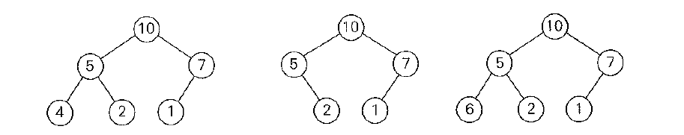
HEAPS AND HEAPSORT
Only the leftmost tree is a heap. Why?

Slide 42
PROPERTIES OF HEAPS
There exists exactly one essentially complete binary tree with n nodes. Its height is equal to floor(log₂n).
The root of a heap always contains its largest element.
A node of a heap considered with all its descendants is also a heap.
A heap can be implemented as an array by recording its elements in the topdown, left-to-right fashion. It is convenient to store the heap's elements in positions 1 though n of such an array, leaving H[O] either unused or putting there a sentinel whose value is greater than every element in the heap. In such a representation,

Slide 43
PROPERTIES OF HEAPS
the parental node keys will be in the first floor(n/2) positions of the array, while the leaf keys will occupy the last ceil(n/2) positions;
the children of a key in the array's parental position i (1 <= I <= floor(n/2)) will be in positions 2i and 2i + 1, and, correspondingly, the parent of a key in position i (2 <= i <= n) will be in position floor(i /2).

Slide 44
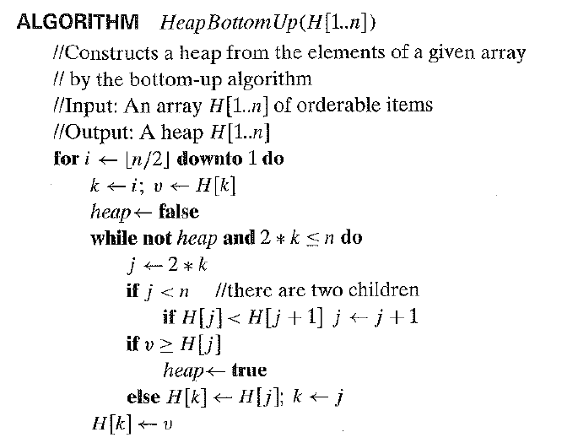
HEAP CONSTRUCTION – BOTTOM UP

Slide 45

HEAP CONSTRUCTION – BOTTOM UP (EFFICIENCY)

Slide 46
HEAP CONSTRUCTION – TOP DOWN
First, attach a new node with key K in it after the last leaf of the existing heap.
Then sift K up to its appropriate place in the new heap as follows.
Compare K with its parent's key: if the latter is greater than or equal to K, stop (the structure is a heap);
otherwise, swap these two keys and compare K with its new parent.
This swapping continues until K is not greater than its last parent or it reaches the root.
In this algorithm, too, we can sift up an empty node until it reaches its proper position, where it will get K 's value.

Slide 47
HEAP CONSTRUCTION – TOP DOWN EFFICIENCY
Efficiency of insertion is O(log n)

Slide 48
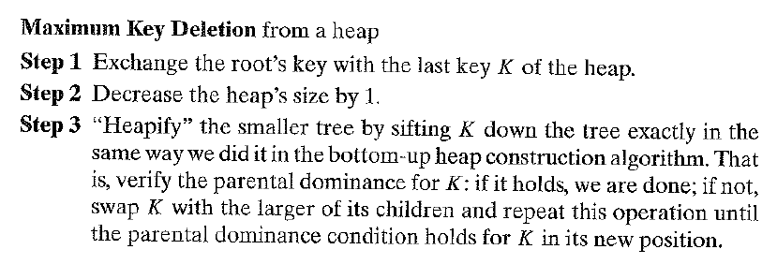
HEAP DELETION
The efficiency of deletion is O(log n).

Slide 49
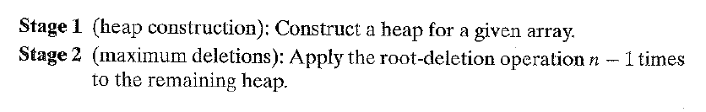
HEAP SORT

Slide 50
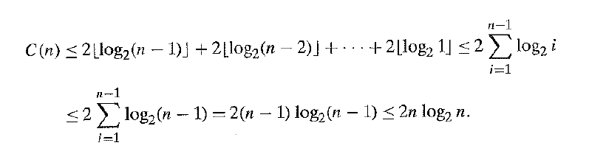
HEAP SORT – EFFICIENCY
The number of key comparisons:
C(n) belongs to O(n log n) for the second stage of Heap Sort.

Slide 51
HEAP SORT – EFFICIENCY
For both stages:
O(n) + O(n log n) belongs to O(n log n).

Slide 52
HORNER’S RULE AND BINARY EXPONENTIATION

Slide 53
PROBLEM
Computing the value of a polynomial:
p(x) = a_{n}x^{n} + a_{n-1}x^{n-1} + …. + a₁x + a₀
at a given point x and its special case of computing x^{n}.

Slide 54
HORNER’S METHOD
Is an algorithm for calculating polynomials.
Named after British mathematician, William George Horner, who published it in the 19th century.
An example of Representation Change variety of Transform – and – Conquer.

Slide 55
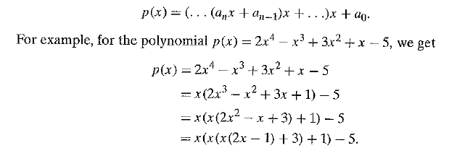
HORNER’S METHOD – Representation Change

Slide 56
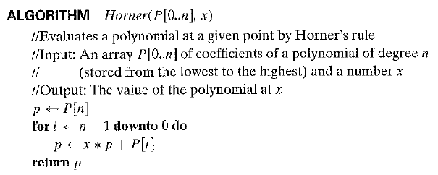
HORNER’S METHOD – Algorithm

Slide 57
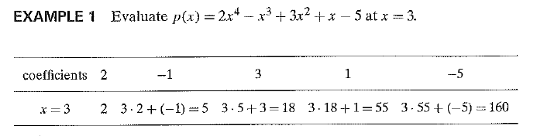
HORNER’S METHOD – Pen and Pencil Evaluation

Slide 58

HORNER’S METHOD – Number of Multiplications and Divisions
Comparison: Using Brute Force design strategy, just to compute a single term a^{n} would have required n multiplications.

Slide 59
PROBLEM
Computing a^{n}.
The Horner’s Rule for computing a^{n} degenerates to the Brute Force multiplication of a by itself.
This can be improvised.
We see two algorithms for computing a^{n} which use the binary representation of the exponent.
The Left – to – right Binary Exponentiation
The Right – to – left Binary Exponentiation

Slide 60

SOLUTION
Computing a^{n}.
Let n = b₁ . . . b_{i} . . . B₀ be a bit string representing a positive integer n in the Binary Number System.
Value of n can be computed as the polynomial:

Slide 61
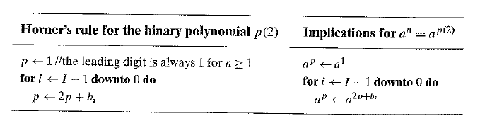

SOLUTION
Let us now compute this polynomial by Horner’s Rule:
But:

Slide 62
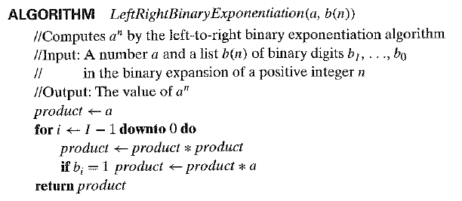
Left – To – Right Binary Exponentiation

Slide 63

Left – To – Right Binary Exponentiation Efficiency
The number of multiplications M(n) is given by:
b – 1 = floor(log₂n)
The efficiency of this algorithm is logarithmic.

Slide 64

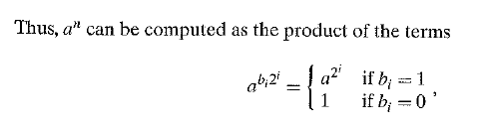
YET ANOTHER SOLUTION
Computing a^{n}.

Slide 65
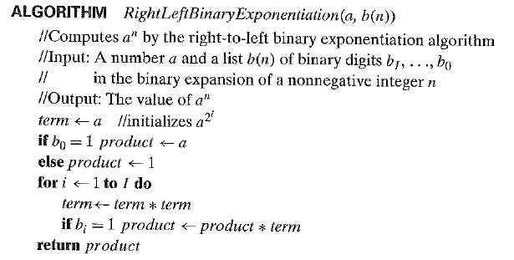
Right – To – Left Binary Exponentiation

Slide 66
Left – To – Right Binary Exponentiation Efficiency
The efficiency of this algorithm is logarithmic.

